Slide 1

Data Science Presentation
From Headlines to Markets: A Data Mining Approach to Decode Financial News Impact on Stocks and Commodities
Mukund Kuthe
Sem: V Section: B
PRN: 23070521082
Ravi Kumar Kushwaha
Sem: V Section: B
PRN: 23070521116
Symbiosis Institute of Technology, Nagpur Campus

Slide 2


Problem Statement
Financial markets are highly influenced by dynamic information sources such as news articles, reports, and policy announcements. These news events directly affect investor sentiment and market behavior across multiple sectors including equities, commodities, and derivatives. However, due to the unstructured nature of textual data and the complexity of market indicators, it becomes challenging to analyze and interpret these relationships effectively.
Hence, there is a need for a data mining-based approach that integrates both structured financial data and unstructured news data to uncover hidden patterns and associations that explain how financial news impacts market performance.

Slide 3
Objectives
To integrate and analyze multiple datasets: financial news, Indian stock market (NSE), futures & options, and commodity market (MCX) data.
To preprocess, transform, and unify structured and unstructured data using a common timeline (Month–Year).
To apply data mining techniques such as association rule mining, classification, and clustering to discover hidden relationships and trends within Indian financial data.
To identify how financial news sentiments influence key Indian market indicators like turnover, delivery percentage, MTM, and commodity value.
To generate interpretable rules and insights that highlight the interdependency between news sentiment and market movement across equity, derivatives, and commodity domains in India.
To visualize and interpret the discovered patterns to support data-driven financial analysis and decision-making in the Indian stock market context.

Slide 4
Dataset Used
Financial News Headlines Dataset (Kaggle)
Source: Kaggle – India Financial News Headlines Sentiments
Type: Unstructured text data
Attributes: Title, Sentiment (Positive/Negative/Neutral), Confidence, Month, Year
Purpose: Provides sentiment polarity of financial news influencing market behavior.
Link:https://www.kaggle.com/datasets/harshrkh/india-financial-news-headlines-sentiments
Capital Market Dataset (NSE)
Source: National Stock Exchange of India (Monthly Settlement Statistics)
Type: Semi-Structured JSON data
Attributes: Turnover (₹ Crores), Delivery Percentage, Trades, Short Delivery Values, Month, Year
Purpose: Represents stock market trading performance and investor participation.
Link: https://www.nseindia.com/report-detail/monthly-settlement-statistics
Futures and Options (F&O) Dataset (NSE)
Source: National Stock Exchange of India
Type: Semi-Structured JSON data
Attributes: MTM (Mark-to-Market), Total Contracts, Premium, Exercises, Month, Year
Purpose: Indicates derivative market trends and speculative trading activity.
Link: https://www.nseindia.com/report-detail/monthly-settlement-statistics
Commodity Market Dataset (MCX)
Source: Multi Commodity Exchange of India (Historical Data)
Type: Structured numeric and categorical data
Attributes: Segment, Commodity, Traded Contracts, Total Value (₹ Lacs), Average Daily Turnover, Month, Year
Purpose: Reflects activity levels and value fluctuations in the Indian commodity market.
Link: https://www.mcxindia.com/market-data/historical-data

Slide 5
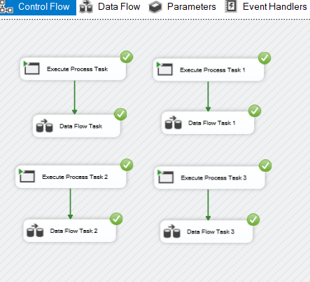
Automated ETL
1. Extract Phase
Execute Process Task components initiate Python or script-based data extraction. Data is fetched automatically from the three sources:
Kaggle (Financial News)
NSE Capital Market and NSE Futures & Options
MCX Commodity Market
Extracted data files (CSV/Excel) are then goes for transformation.
2. Transform Phase (Data Cleaning and Integration)
Each Data Flow Task performs cleaning and transformation operations.
Key operations include:
Removing duplicates and null values.
Standardizing Month–Year across all datasets.
Sentiment normalization (Positive, Negative, Neutral) for news data.
3. Load Phase
Cleaned and transformed data is then loaded into the final SQL tables. Each Data Flow Task corresponds to one dataset being loaded:
Task: Loads News data
Task 1: Loads Capital Market data
Task 2: Loads F&O
Task 3: Commodity data
The workflow ensures automation and reusability, allowing the ETL process to be re-run without duplication by truncating old records before reloading.
Fig : Automated ETL Process

Slide 6
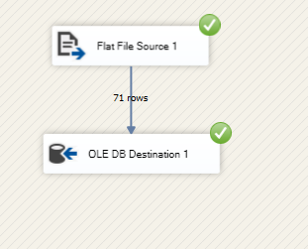
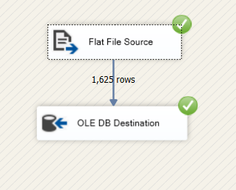
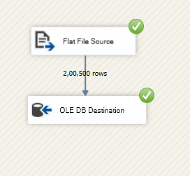
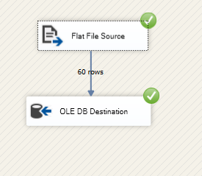
SSIS To SSMS Data Flow
This data flow in SSIS establishes a direct connection between the Flat File Source (CSV dataset) and the OLE DB Destination in SQL Server Management Studio (SSMS), enabling automated data transfer from external files into SQL tables. It ensures smooth and validated loading of cleaned financial data, such as news sentiments and market statistics, into the database, forming the final step of the ETL process for further data mining and analysis.
This connection ensures seamless synchronization between extracted datasets and the centralized data warehouse, maintaining data consistency and integrity across multiple sources. By automating the transfer through SSIS, the process eliminates manual intervention, reduces loading errors, and prepares integrated financial data for subsequent analytical operations such as pattern discovery, association rule mining, and performance visualization within SSMS or Power BI.

Slide 7
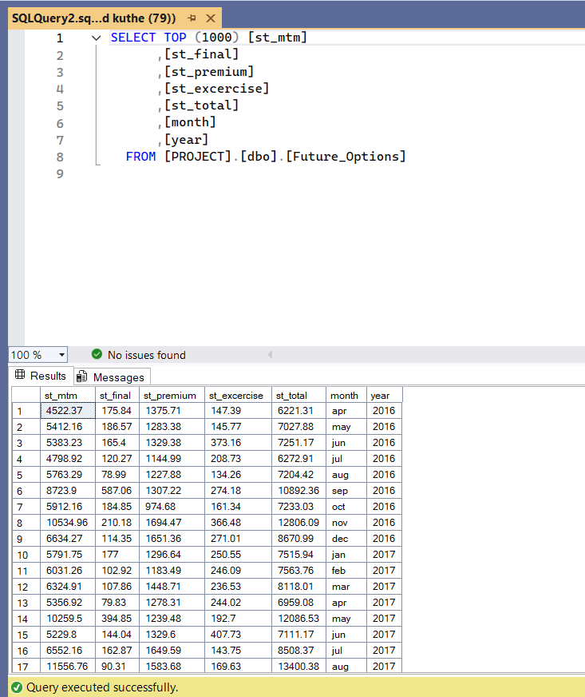
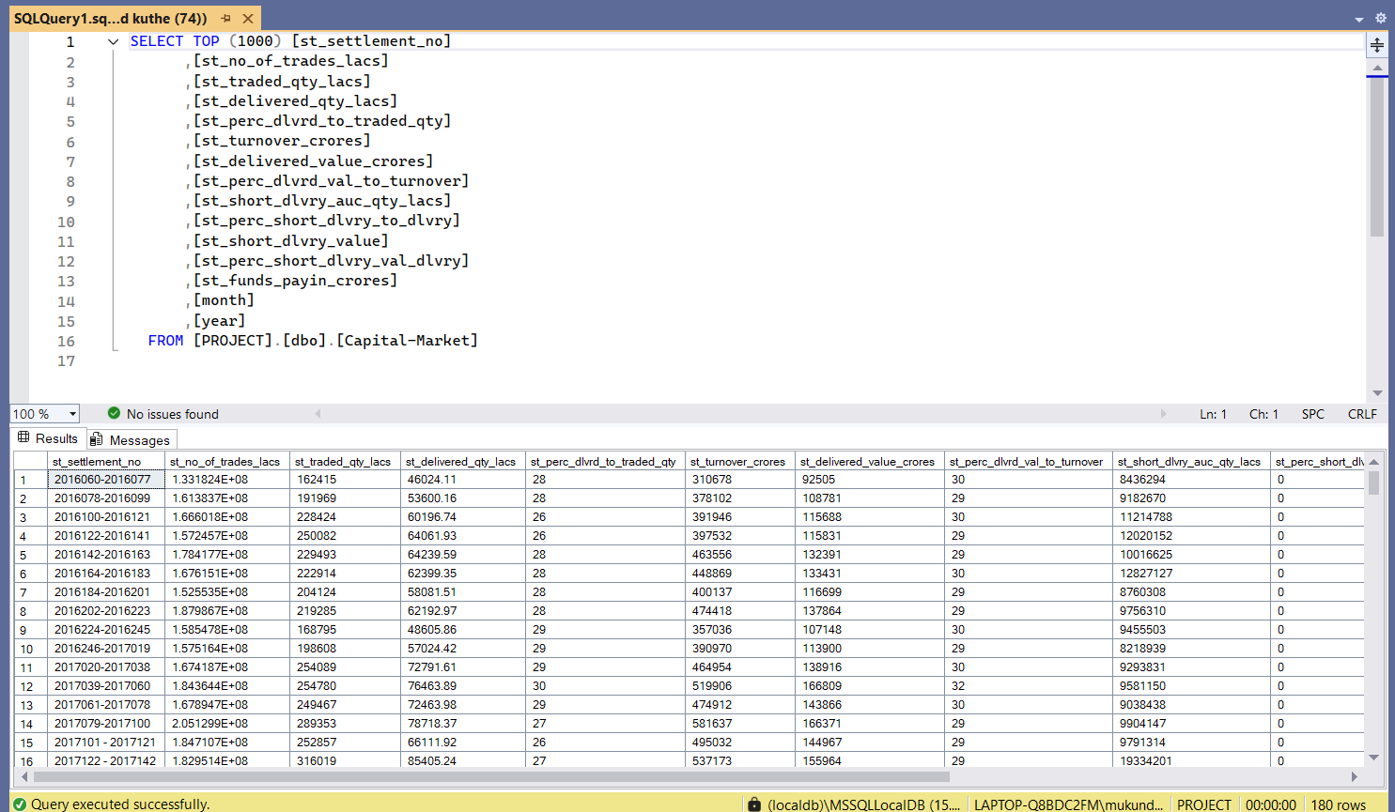
SSMS Data View

Slide 8
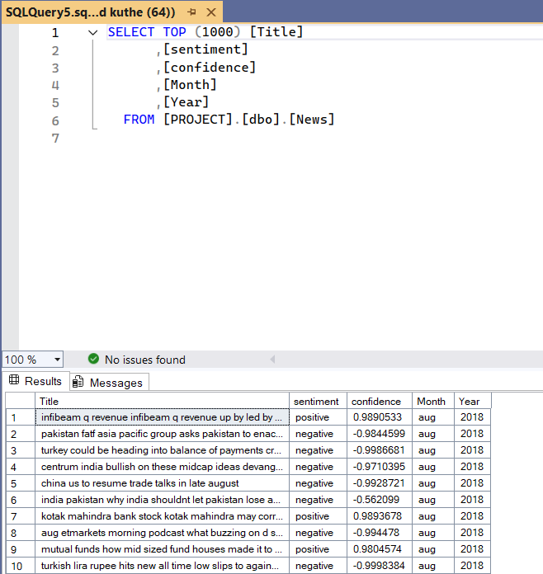
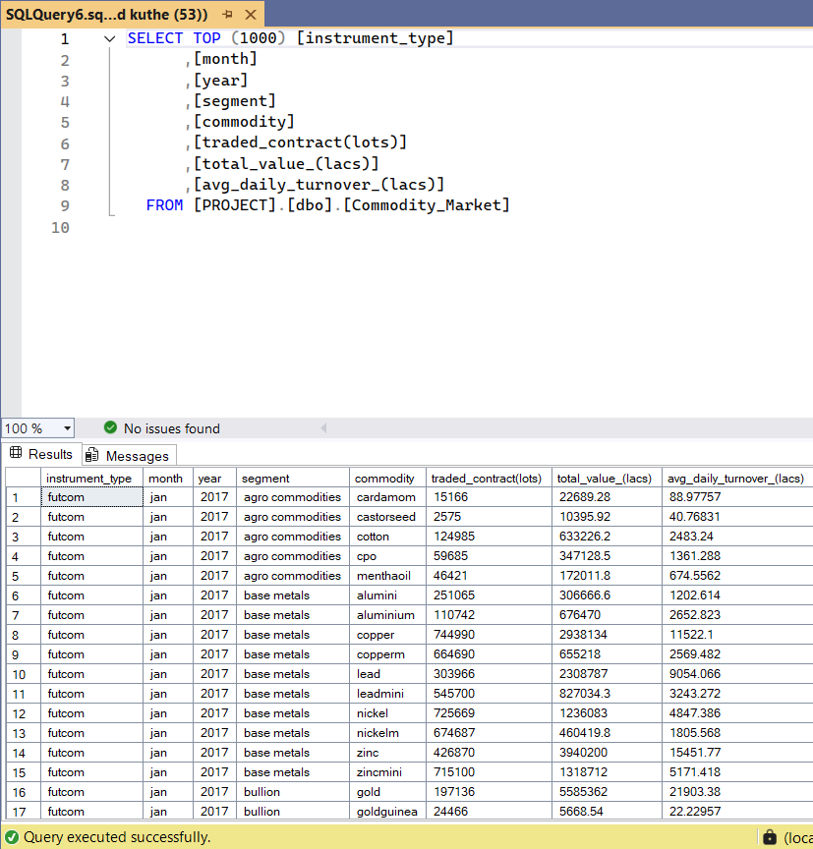
SSMS Data View

Slide 9
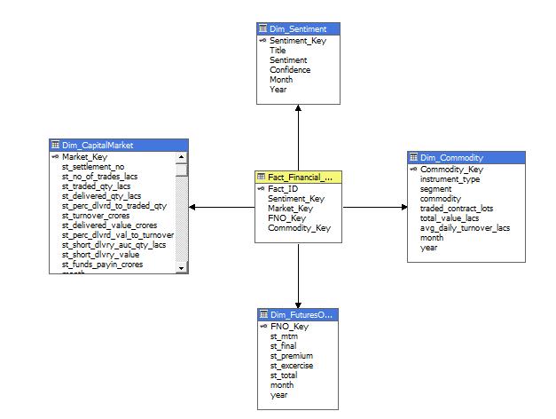
Cube Deployment
The cube deployment process is carried out using SQL Server Analysis Services (SSAS), which enables multidimensional analysis. The star schema, consisting of a central Fact table and multiple Dimension tables, serves as the foundation for building the OLAP cube. In SSAS, dimensions Sentiment, Capital Market, Futures & Options, and Commodity are processed to define hierarchies and relationships. The Fact table acts as the measurable component, storing key metrics like turnover and market performance.
This structured cube allows to perform complex queries, drill-downs, and aggregations seamlessly, facilitating faster and deeper financial insights. Once the cube is designed in SSAS, it is deployed and processed through SQL Server Management Studio (SSMS), ensuring integration with the existing PROJECT database. SSMS enables verification of relationships, measure groups, and data integrity within the cube.
Fig : Dimension and Fact Table

Slide 10
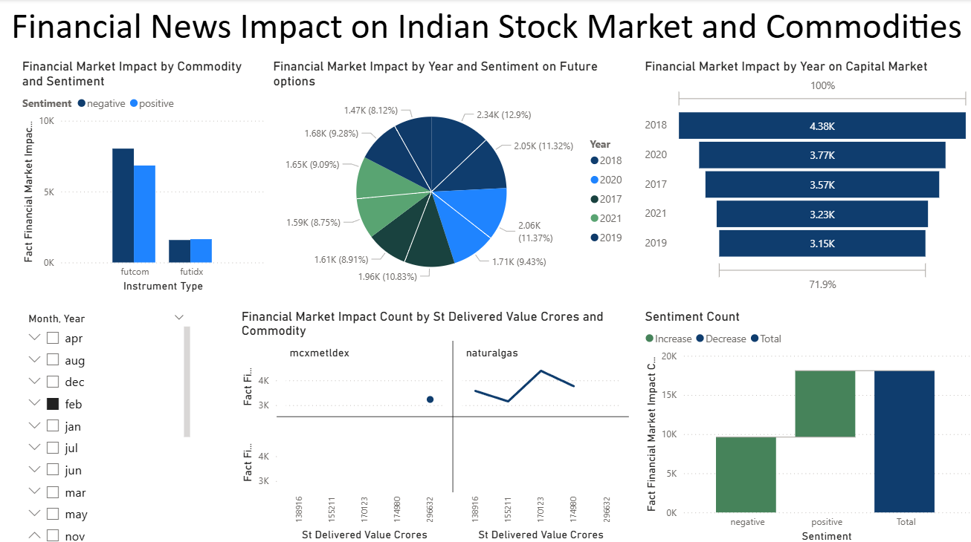
Power BI Dashboard
Power BI dashboard titled “Financial News Impact on Indian Stock Market and Commodities” provides a comprehensive analysis of how financial news sentiment influences different market segments. The visualizations highlight the relationship between sentiment (positive or negative) and financial market impact counts across commodities, futures, and capital markets. The bar and line charts illustrate how market reactions vary by year, commodity type, and delivered value, while the pie chart breaks down impact trends over time. Additionally, the sentiment count chart summarizes increases or decreases in market influence, offering a clear comparison between positive and negative news. Slicers for month and year allow users to filter insights dynamically, making this dashboard an effective tool for tracking sentiment-driven financial behavior and market dynamics.
Fig : Power BI Dashboard

Slide 11
Power BI Dashboard

Slide 12
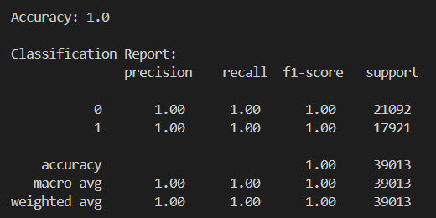
Data Mining
Classification
The Random Forest Algorithm (RFA) was chosen for classification because of its robustness, ability to handle large datasets, and effectiveness with both numerical and categorical variables. RFA operates by constructing multiple decision trees and aggregating their results to achieve higher accuracy and prevent overfitting. In this project, the algorithm was applied to predict the sentiment of financial news based on multiple market and commodity indicators such as turnover, traded contracts, total value, and confidence levels.
The model achieved an accuracy of 100%, indicating strong correlations between financial indicators and sentiment trends. This demonstrates that the Random Forest model efficiently captured the patterns and dependencies within the data, making it a reliable tool for analyzing the impact of financial activities on market sentiment.
Fig : Random Forest Classifier Result

Slide 13
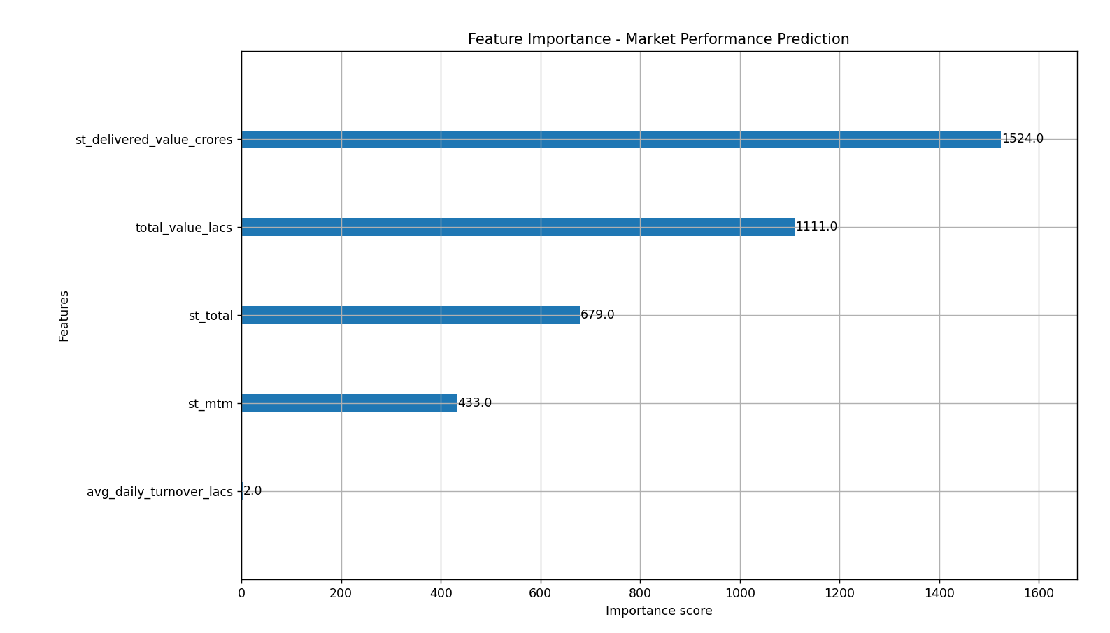
Data Mining
2. Feature Importance Analysis – XGBoost Model
The feature importance plot highlights the key financial parameters influencing market performance prediction as determined by the XGBoost classifier. Among all the input features, ‘st_delivered_value_crores’ emerged as the most dominant factor, indicating that delivery value in crores has the greatest impact on market performance outcomes. It is followed by ‘total_value_lacs’ and ‘st_total’, which also contribute significantly to model predictions.
In contrast, ‘avg_daily_turnover_lacs’ and ‘st_mtm’ show relatively lower influence. This analysis demonstrates how XGBoost effectively identifies the most influential financial indicators, helping in understanding which parameters drive positive or negative market trends.
Fig : Feature Importance Analysis

Slide 14
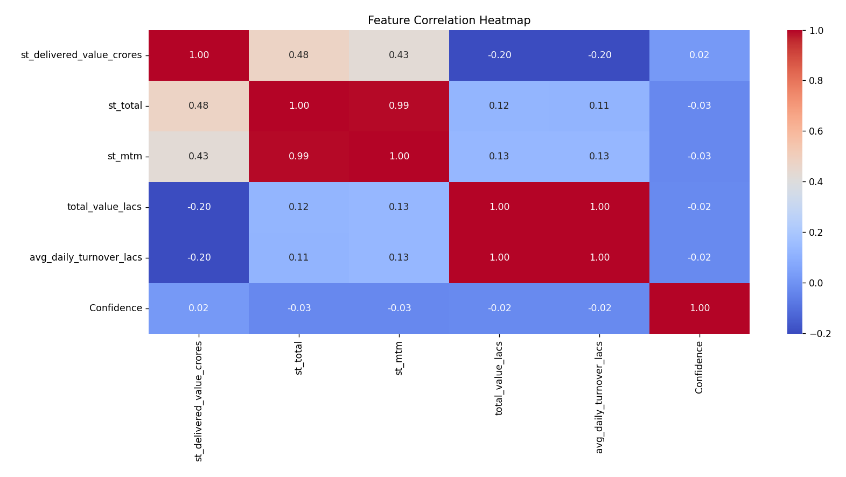
Data Mining
3. Feature Correlation Heatmap
The correlation heatmap visualizes the strength and direction of relationships between key financial indicators. A strong positive correlation is observed between ‘st_total’ and ‘st_mtm’ (0.99), indicating that both metrics move closely together in market behavior. Similarly, ‘st_delivered_value_crores’ shows a moderate positive relation with ‘st_total’ and ‘st_mtm’, suggesting their combined influence on market activity.
Conversely, ‘total_value_lacs’ and ‘avg_daily_turnover_lacs’ show mild negative correlations with other variables, implying independent contribution patterns. The overall correlation structure highlights how delivery and turnover metrics are tightly linked, while confidence remains largely independent, ensuring balanced predictive insights.
Fig : Feature Correlation Heatmap

Slide 15
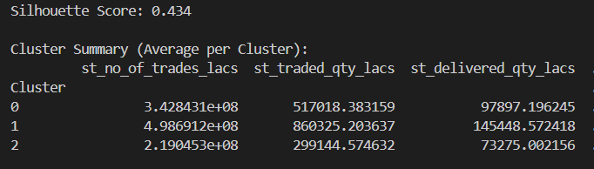
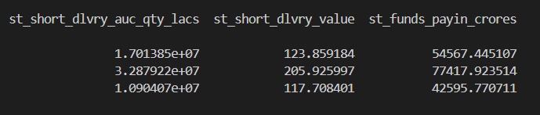
Data Mining
4. K-Means Clustering
K-Means clustering was applied to group market data based on trading and fund-related indicators such as trade volume, delivery quantity, and fund pay-ins. The model automatically divided the dataset into three distinct clusters, achieving a Silhouette Score of 0.434, indicating reasonably well-separated and meaningful groupings.
Cluster 1 : high-performing markets,Cluster 0 : moderate activity markets and Cluster 2 : low-activity markets. These insights help classify financial market patterns, allowing for better understanding of trading behavior, fund movement, and market performance trends.
Fig : K-Means Clustering Results

Slide 16
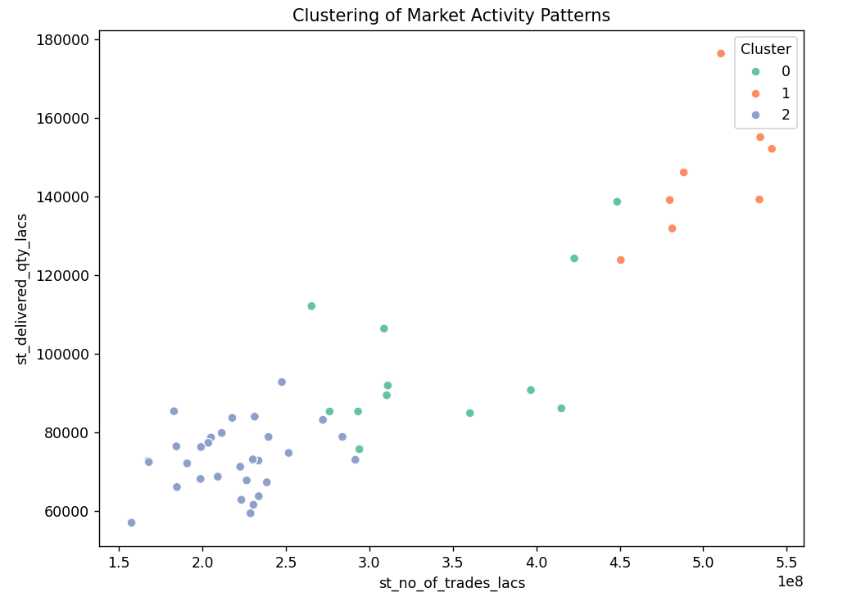
Data Mining
5. Cluster Visualization
The scatter plot represents the clustering of market activity patterns based on the number of trades and delivered quantities. Using K-Means, the data was divided into three distinct groups, each shown with a different color. Cluster 1 (orange) indicates high-trade, Cluster 0 (green) represents moderate-performing markets, and Cluster 2 (blue) shows low-activity markets with fewer trades and deliveries.
The clustering results provide a clear view of how trading and delivery volumes group together in different market conditions. This visualization helps in easily spotting high-performing and low-performing segments, making it useful for understanding overall market dynamics and performance trends.
Fig : Cluster Visualization

Slide 17
Data Mining
6. Association Rule Mining
Association Rule Mining was applied to explore relationships between instrument type, segment, and commodity using the Apriori algorithm. The rules revealed strong and consistent associations, such as FUTCOM instruments always being linked to the Energy segment and Natural Gas trading, while FUTIDX instruments are consistently related to the Index segment and MCX Metal Index commodities. With a perfect confidence score (1.0) and high lift values (up to 7.11), these rules highlight stable trading patterns and interdependencies in the market, providing valuable insights for commodity–instrument alignment and trading strategies.
The results show a clear segmentation pattern where energy-related commodities are primarily traded through FUTCOM instruments, while index-based assets are traded via FUTIDX instruments. This pattern reflects a well-defined alignment between product categories and their preferred trading mechanisms. Such relationships can assist financial analysts and policy makers in understanding market concentration, improving product classification, and optimizing trading strategies.
Antecedent (IF) | Consequent (THEN) | Confidence | Lift | Meaning
instrument_type_futcom | segment_energy | 1.0 | 1.16 | Every FUTCOM instrument is always traded in the Energy segment
segment_index | instrument_type_futidx | 1.0 | 7.11 | All Index segments are associated with FUTIDX instruments
commodity_naturalgas | instrument_type_futcom | 1.0 | 1.16 | Whenever Natural Gas is traded, it is always via FUTCOM instruments
commodity_mcxmetldex | instrument_type_futidx | 1.0 | 7.11 | MCX Metal Index commodities are always linked with FUTIDX instruments
Fig : Association Rule Mining Results

Slide 18
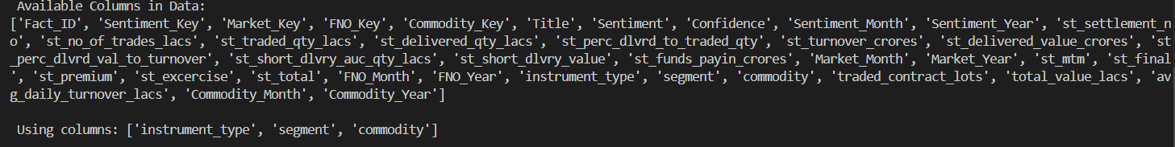
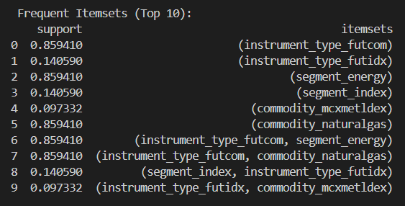
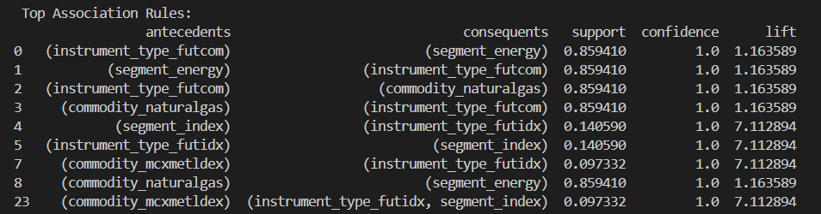
Data Mining
Fig : Association Rule Mining Results

Slide 19


